Slide 1
Applications of NLP in Privacy Policies – Update II
Pawan Sasanka Ammanamanchi – MS by Research in CSE 2nd year– 2020701028
Ankita Maity – MS by Research in CSE 1st year- 2021701017

Slide 2
Project Idea/ Problem Statement
Can we detect the readability of the privacy policies?
Can we make the readability of privacy policies better?

Slide 3
Models
Per feedback, setting up baseline models to compare the approach to GPT-3
Using variety of summarization models – As Baseline
BART
Pegasus (Removed) – Extractive Outputs
GPT-3 - Current State of the art language model

Slide 4
Evaluation Metrics (Automated)
Flesch Kincaid Reading score (The Lower the better) - Approximate reading grade level of a text.
Flesch Reading Ease score (The Higher the better) – Scores along complexity of sentences and words, but assumes that long words are necessarily complex
Gunning Fog Score (The Lower the better) – Upgrade of Flesch Reading Ease Score, Calculates percentage of complex words as percentage of total while measuring
SMOG Score (The Lower the better) – Useful for Health Readability, Domains with High Technicality, Adjusts score for complexity of words

Slide 5
Trends Observed
GPT-3 always results in improving readability of the privacy policy
BART improves on SMOG and FOG scores but consistently sacrifices plain readability of the document
BART outputs are very precise
GPT-3 outputs are more open ended but understandable
Both the approaches improve on readability of underlying document

Slide 6
Potential issues of using NLP models
Summarization is Lossy compression of Privacy policies
Information may be lost
Key terms may be lost (Legalese)
Abstractive Models have biases and some of these biases manipulate information
Intrinsic Bias (information found in source document is misrepresented)
Extrinsic Bias (Information not found in source document is added)
Sensitivity to Hyperparameters (Initial cost of deployment)
Human Guidance REQUIRED!

Slide 7
What is left?
Human Evaluation of Outputs and preferences
Do they prefer readable privacy policies more?
Are the readable privacy policies helping them understand the information?

Slide 8
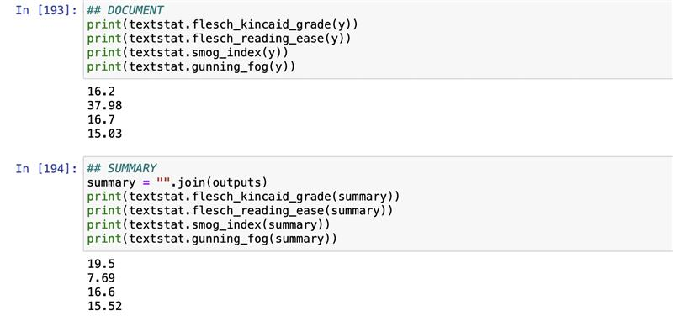
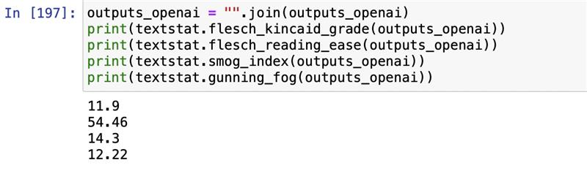
Scores of a Health Privacy report [KALEIDA HEALTH]
[1:59 pm] Pawan Sasanka Ammanamanch
[2:00 pm] Pawan Sasanka Ammanamanch

Slide 9
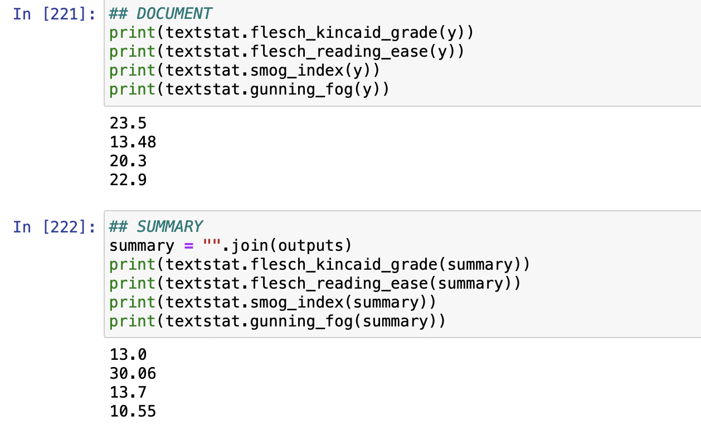
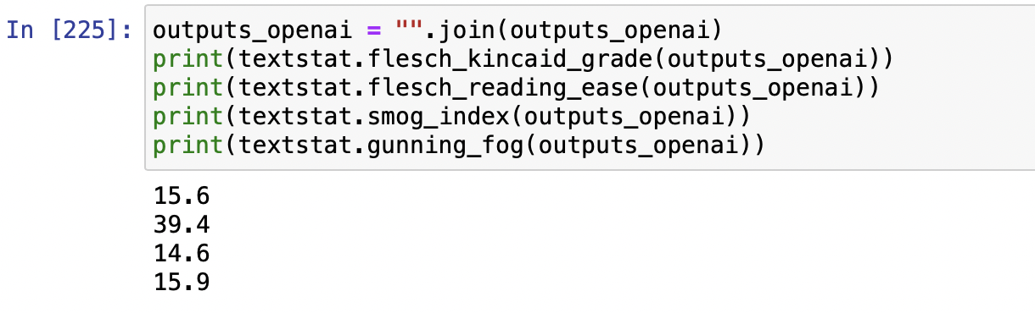
Scores for TED Privacy Policy

Slide 10
BART Output for TED
"TED encourages its community to discover and share ideas with one another. This privacy policy is intended to inform you of what information we collect and how this information is used. We collect two kinds of information: personal information that you provide directly to us and non-personal information.TED.com has no responsibility to publish, remove or edit any of your comments, conversations or other content. We use various technologies to manage TED.com and track use of the content we provide. Non-personal information that we collect may be combined with information you provide directly to us. Third parties may perform tasks on our behalf.TED.com's privacy policy includes the TED.com Terms of Use. We may use the information that we collect to prevent illegal activities. Third parties may independently collect data about you. We do not control the privacy practices of these third - party services."

Slide 11
GPT3 Output for TED
"When you use the internet, people can read everything you write. They can see what you buy, what you search for, and what you say to other people. They can use this information to send you messages.\n||| We are not responsible for the personally identifiable information you choose to submit in these forums, and we have no responsibility to publish, remove or edit any of your comments, conversations or other content. For more information, see the TED.com Terms of Use. ||| When you share or recommend any TED.com content using your Facebook profile, your action is governed by Facebook's privacy policy. Likewise, when you share or recommend any TED.com content through other social media outlets, your actions are governed by their privacy policies. ||| InformationWe may use the information we collect to prevent illegal activities, to enforce the TED.com Terms of Use, or as otherwise required by law. In addition to the uses identified above, we may use the information we collect for any other purposes disclosed to you at the time we collect your information or pursuant to your consent. Please note that third parties may independently collect data about you, including your IP address and information about the websites you visit and the links you click, through cookies, clicks on links, or other means when you visit or view ads on"

